Slide 1
DRRP’s Updated MOU: Implementing the Transition Plan for Monitoring and Maintenance
Daniel Oppenheimer
Tamarisk Coalition

Slide 2
The Original DRRP MOU
Completed in December 2010
Purpose: affirm commitment to implement Dolores River Riparian Action Plan
Period: 2010 – 2015
Benefits: clarified roles and responsibilities, provided powerful tool for fundraising

Slide 3
Flash Forward to April 10, 2014:
DRRP Transition Plan for Monitoring and Maintenance approved at spring partnership meeting
Period: 2015 – 2019
Purpose: to protect shared
restoration investments
Next step identified: updating
the existing MOU

Slide 4
Updating the existing MOU
Update > replace existing MOU
Sent draft to DRRP on Oct. 14th to review
Today, we will review updates, vet content, & discuss next steps for finalizing

Slide 5
Signatories - Section:
Kept the original 20 signatories
Update: added several other important partners that have become involved since 2010, e.g.
Gateway Canyons Resort
Bureau of Reclamation
Question: Who are we missing?

Slide 6
Background and Purpose - Section:
Update: shift from implementing DR-RAP to implementing the Transition Plan
“To build on the first five years of collaboration to protect the shared investment in restoring the riparian corridor of the Dolores River, as outlined in the Dolores River Restoration Partnership (DRRP) Transition Plan for Monitoring and Maintenance (Transition Plan)”

Slide 7
Authority - Section:
Kept the regulations from 2010 version (for BLM, US FWS, and NRCS)
Update: added language for other organizations
If applicable, please send me your laws, regulations, & policies to add to this section

Slide 8
Statement of Mutual Benefits - Section:
Update: shift from DR-RAP actions to Monitoring and Maintenance actions outlined in the Transition Plan, e.g.
Securing long-term funding
Communications efforts

Slide 9
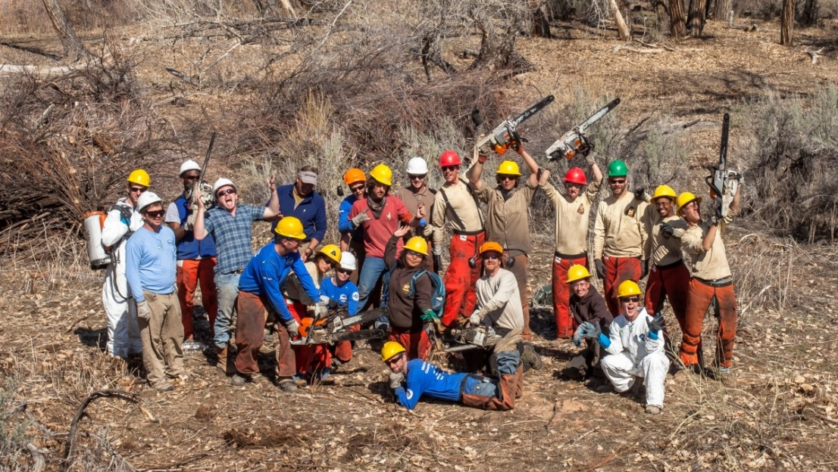
No changes to several Sections:
Terms of Agreement
Principal Contacts
Required Clauses
Signatories – Authorized Representatives
Termination: no change, other than added ‘30 day’ clause
No changes to key phrase:
“Nothing in this MOU shall obligate the signatory or their agency, community, or organization to obligate or transfer funds.”

Slide 10
Roles and Responsibilities – Section:
Update: got rid of “primary” and “secondary” partner language
Update: given that organizations and agencies have evolved since 2010 in terms of opportunities, restrictions, and interests, this was captured here (based on 2013 survey and ongoing conversations)
Question: Are you ok with how your entity is captured?

Slide 11
Decision Making and Allocation of Resources – Section:
Kept language for how we do business (consensus, using best available knowledge)
Update: meet annually > biannually
Update: since the Transition Plan is a living document, make major decisions to adapt the Plan at these annual meetings

Slide 12
Subcommittees – Section:
Update: subcommittees have evolved since 2010, e.g.
Creation of Implementation SC
Integration of Grazing Management & Private Lands SC’s into the Implementation SC
Creation of Core Team
Acknowledgment of continued refinement of governance structure in the future

Slide 13
So, what do you think of the updated MOU?
Thoughts, suggestions, questions, concerns?
Who are we missing?
If applicable, please send me your laws, regulations, & policies to add to this section
Are you ok with how your entity is captured?
What else?

Slide 14
Proposal for next steps:
Send your written comments by Friday, November 14 to me at: doppenheimer@tamariskcoalition.org
Comments integrated in late November
Collect signatures at beginning of 2015
Sound ok? Other ideas?

